Slide 1

EMPOWERING THE NATION
GROUP 7 OF GROUP 1

Slide 2

DEVELOPER
Kutlwano Baloyi
Who oversees the presentation, is the spokesperson and developer on all endeavors regarding the both the coding and CSS of the Empowering The Nation website and mobile app.

Slide 3

DEVELOPER Kutlwano Baloyi ST10249714

Slide 4
INTRODUCTION
Empowering The Nation was established in 2018 and offers courses in training of the following elements of work in Johannesburg South Africa.
Hundreds of aspiring & existing domestic workers and gardeners stand the opportunity to be exclusively trained according to their own available budget & their own available time.
Thee Empowering The Nation courses offers both six-month long learnerships as well as a separate six-week short term skills training tailer made for potential customers.
Empowering The Nation also offers esteemed courses where domestic workers and gardeners can empower themselves to provide more marketable skills.

Slide 5
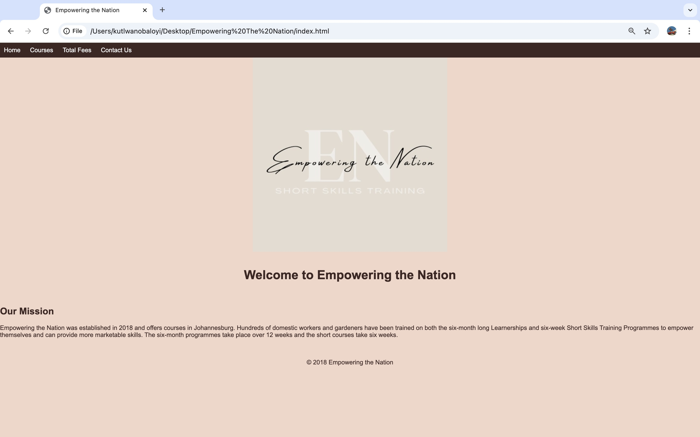
EMPOWERING THE NATION Website Homepage

Slide 6
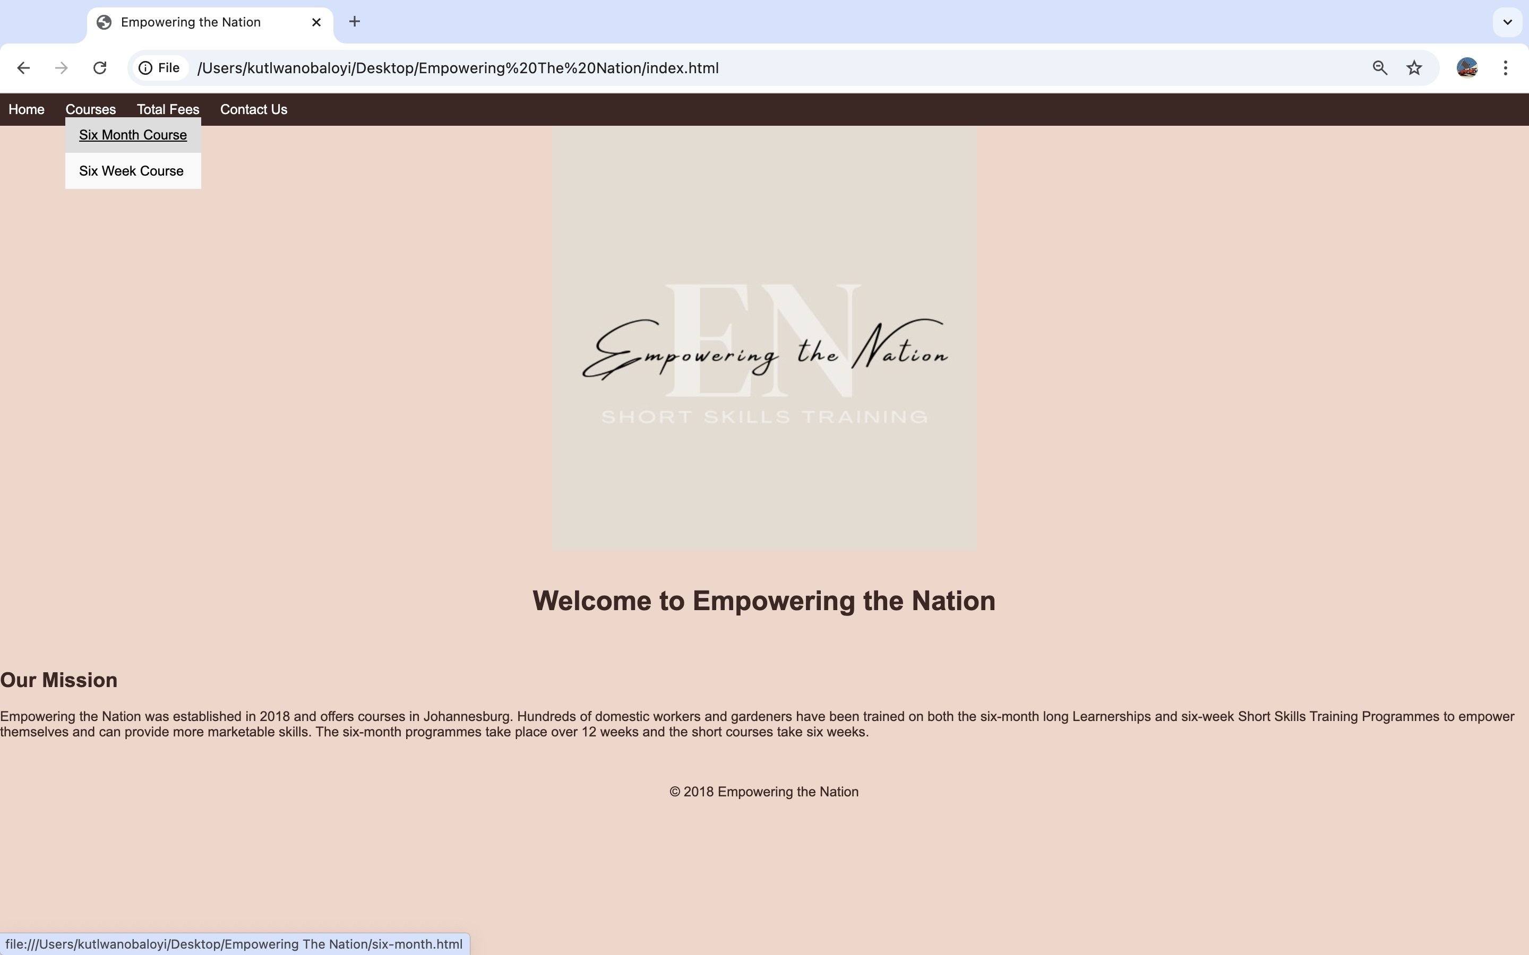
EMPOWERING THE NATION HOME PAGE DROP DOWN MENU

Slide 7
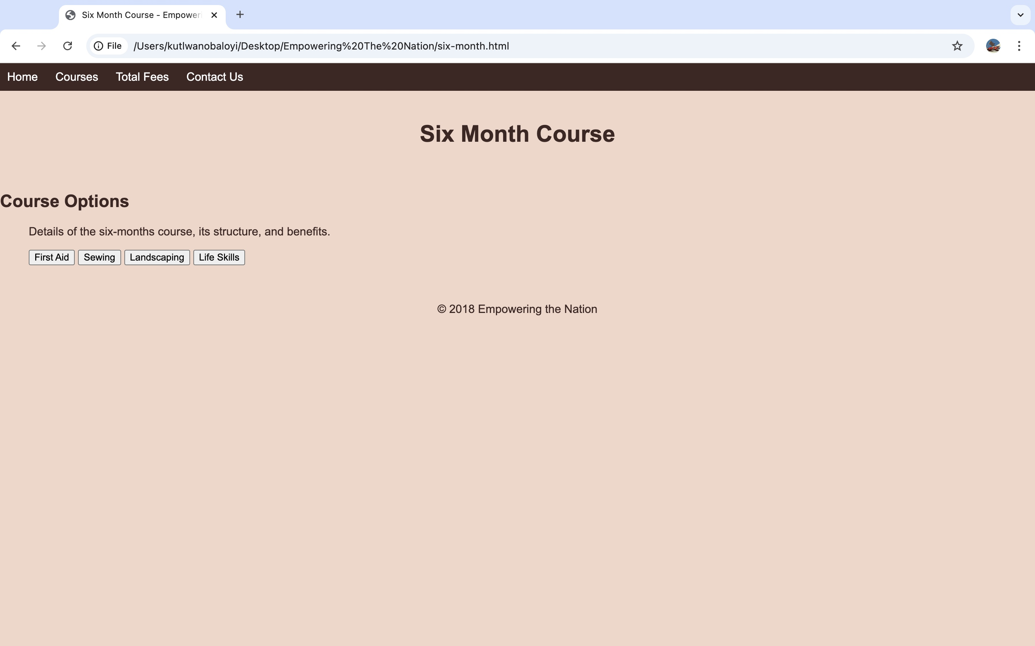
EMPOWERING THE NATION SIX-MONTH COURSE PAGE

Slide 8

EMPOWERING THE NATION FIRST-AID PAGE

Slide 9
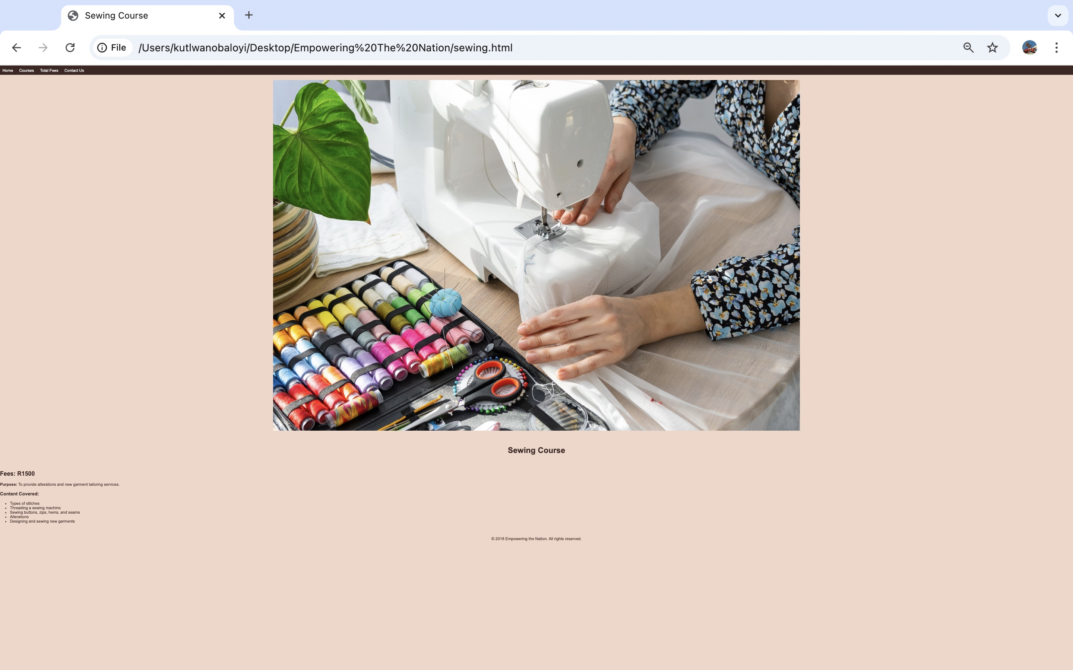
EMPOWERING THE NATION SEWING PAGE

Slide 10
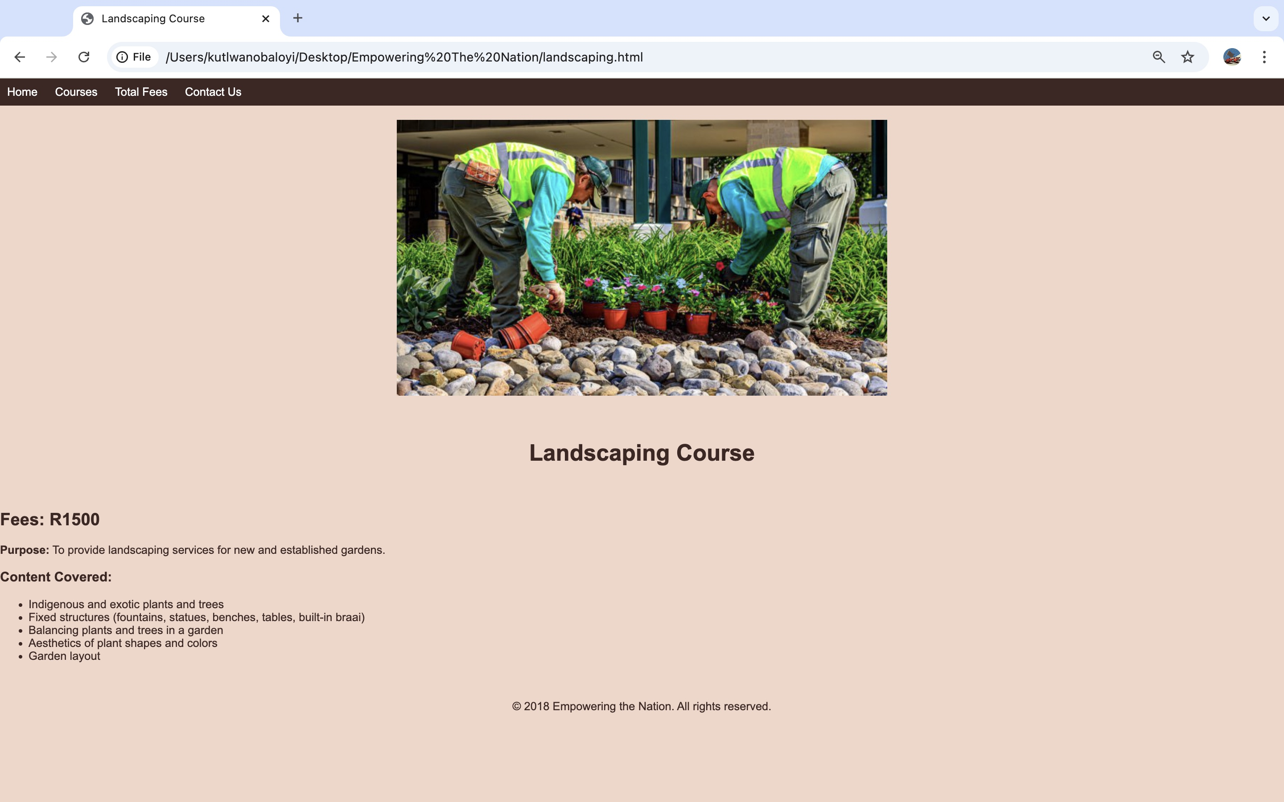
EMPOWERING THE NATION LANDSCAPING PAGE

Slide 11

EMPOWERING THE NATION LIFE SKILLS PAGE

Slide 12

EMPOWERING THE NATION SIX-WEEK COURSE PAGE

Slide 13
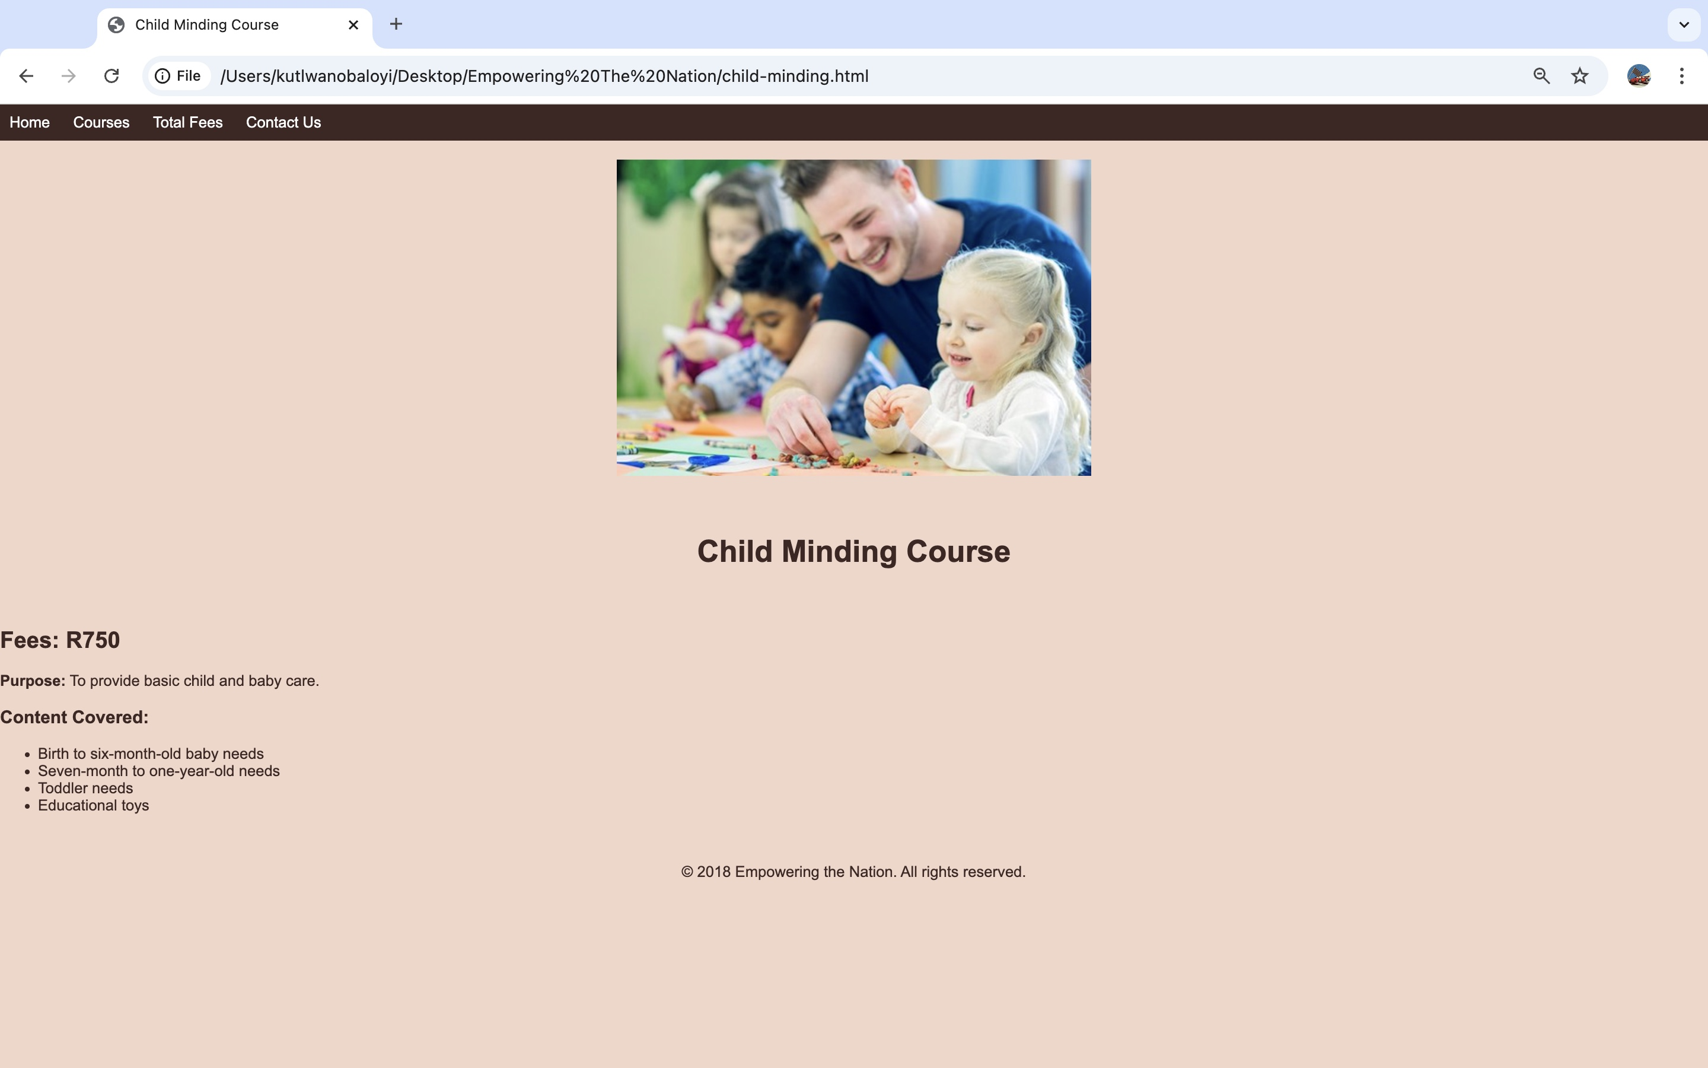
EMPOWERING THE NATION CHILD MINDING PAGE

Slide 14
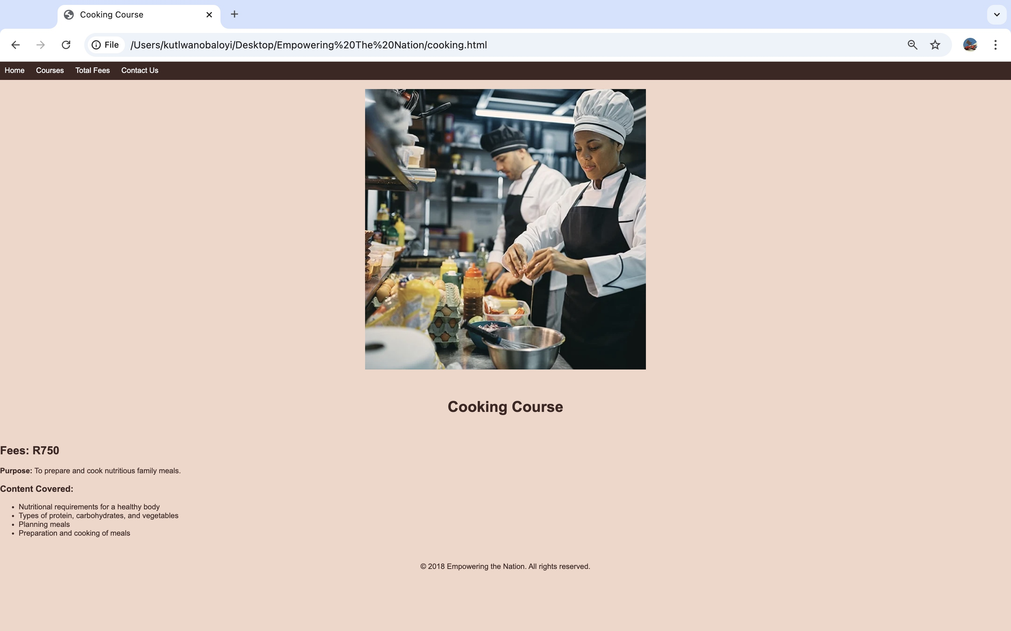
EMPOWERING THE NATION COOKING PAGE

Slide 15
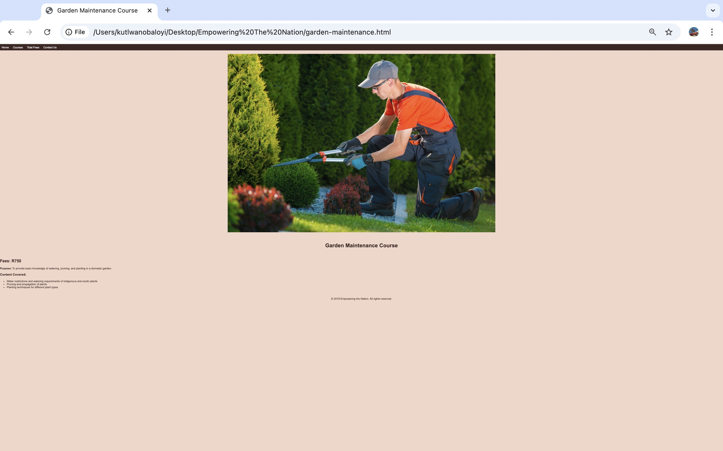
EMPOWERING THE NATION GARDEN MAINTENANCE PAGE

Slide 16
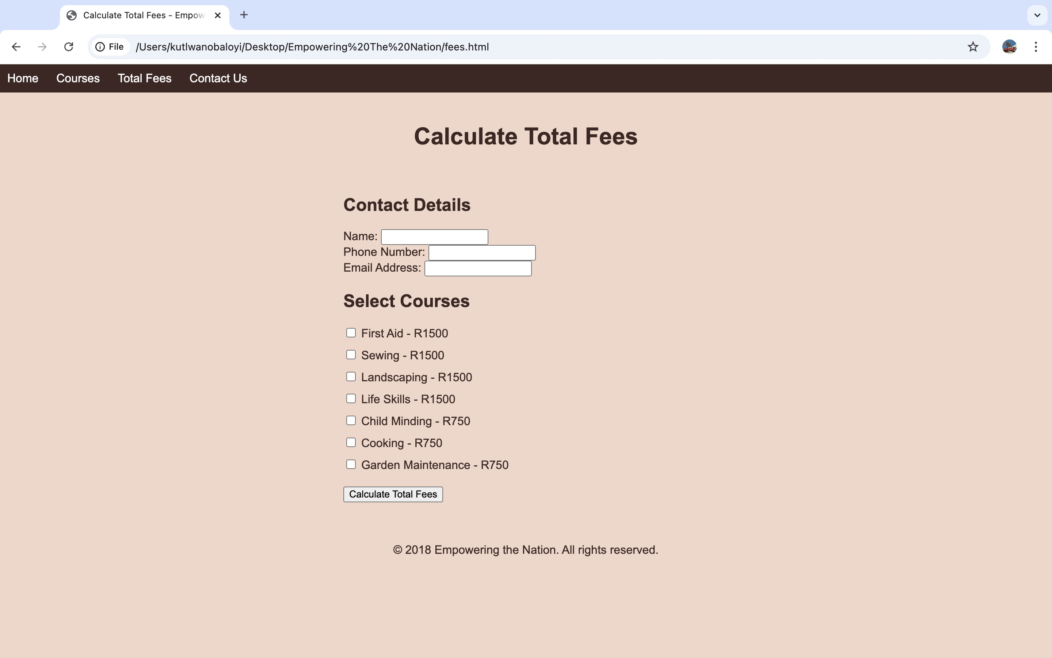
EMPOWERING THE NATION PERSONAL DETAILS, FEES AND COURSE SELECTION PAGE

Slide 17
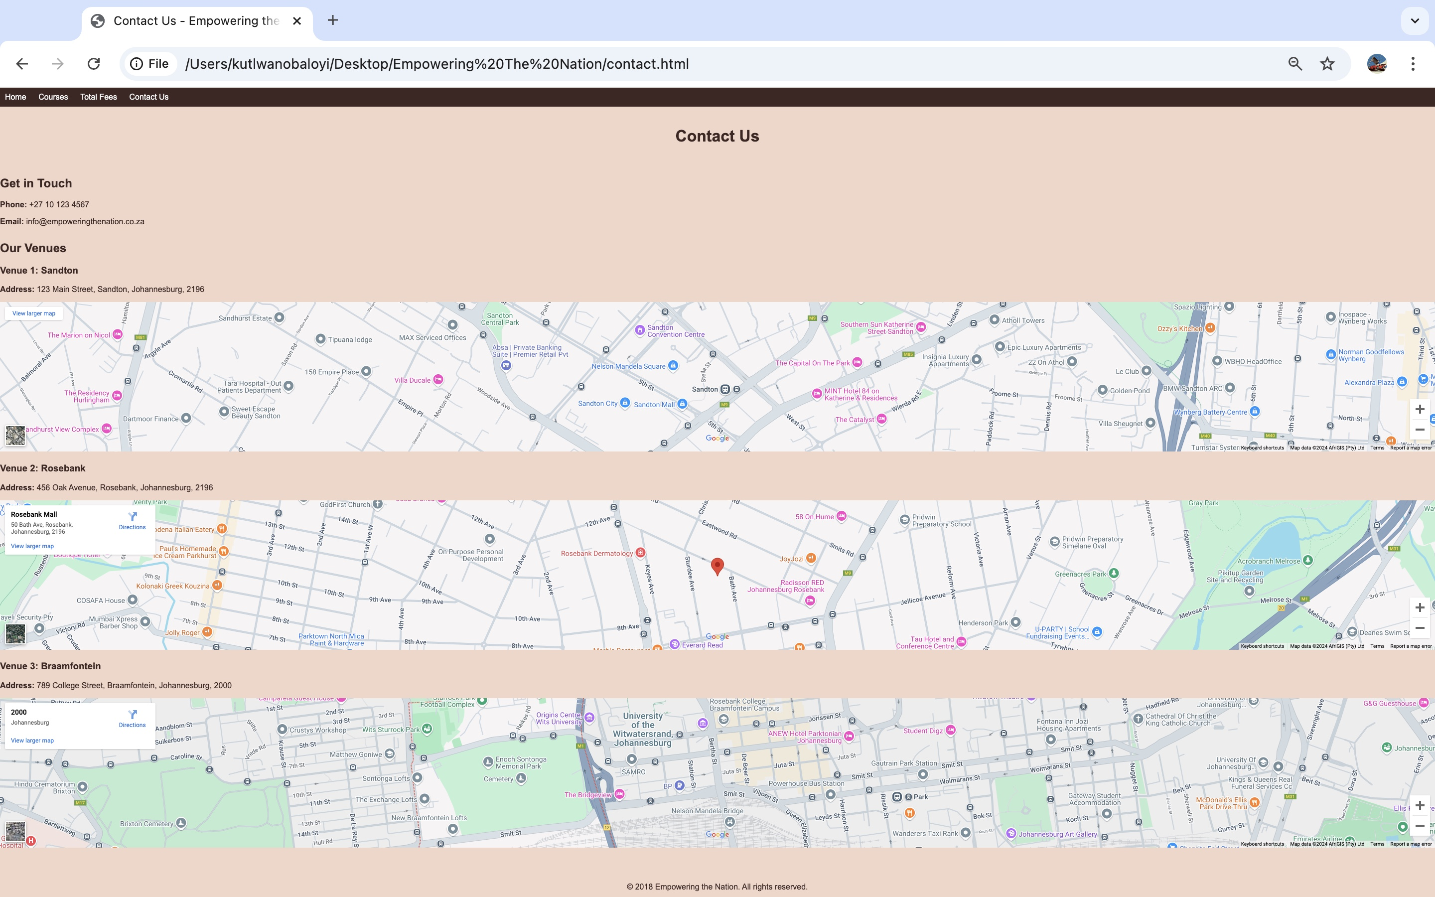
EMPOWERING THE NATION CONTACT US AND LOCATIONS

Slide 18

EMPOWERING THE NATION APP LOGIN SCREEN

Slide 19

EMPOWERING THE NATION WELCOME/HOME SCREEN

Slide 20

EMPOWERING THE NATION SIX WEEKS COURSES SCREEN

Slide 21

EMPOWERING THE NATION CHILD MINDING SCREEN

Slide 22

EMPOWERING THE NATION COOKING SCREEN

Slide 23

EMPOWERING THE NATION GARDEN MAINTENANCE SCREEN

Slide 24

EMPOWERING THE NATION SIX MONTH COURSES SCREEN

Slide 25
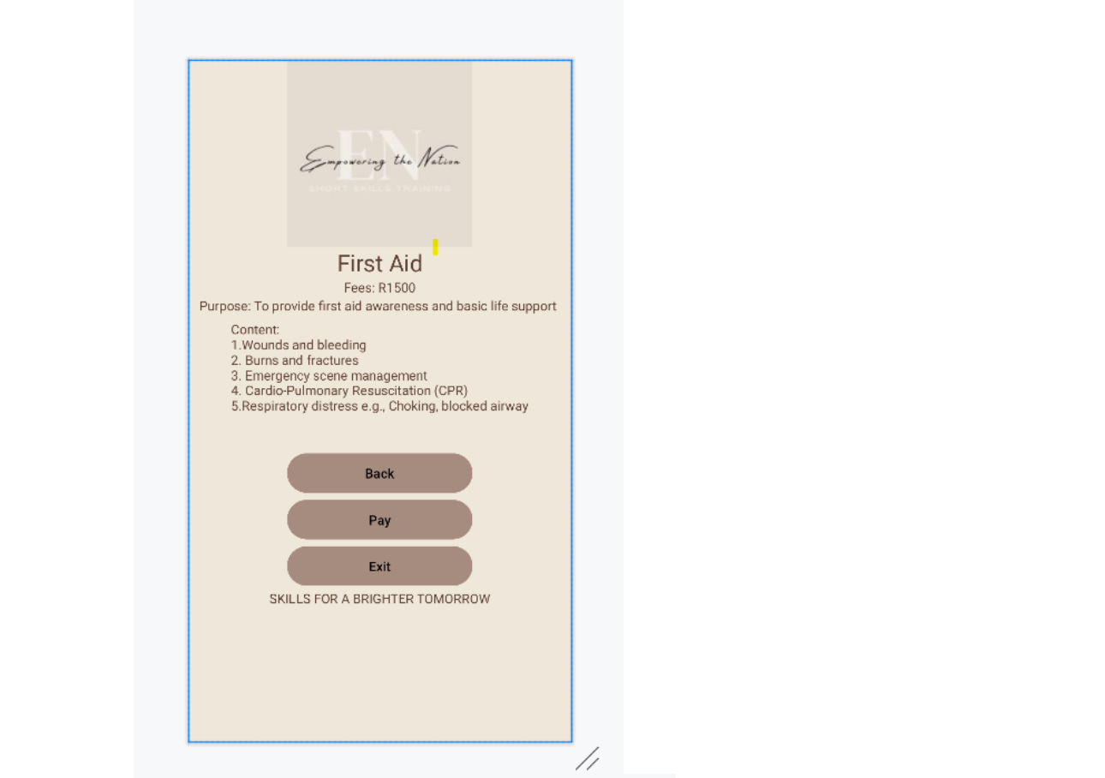
EMPOWERING THE NATION FIRST AID SCREEN

Slide 26
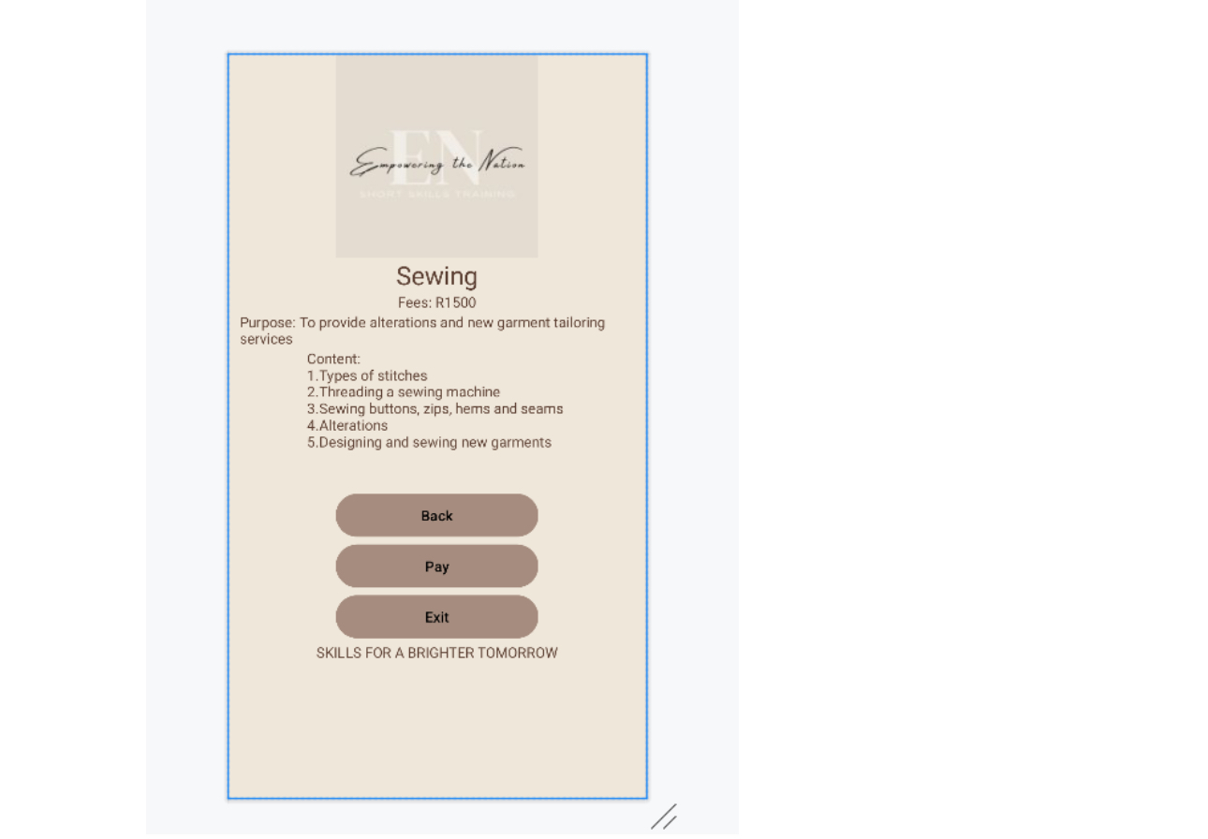
EMPOWERING THE NATION SEWING SCREEN

Slide 27
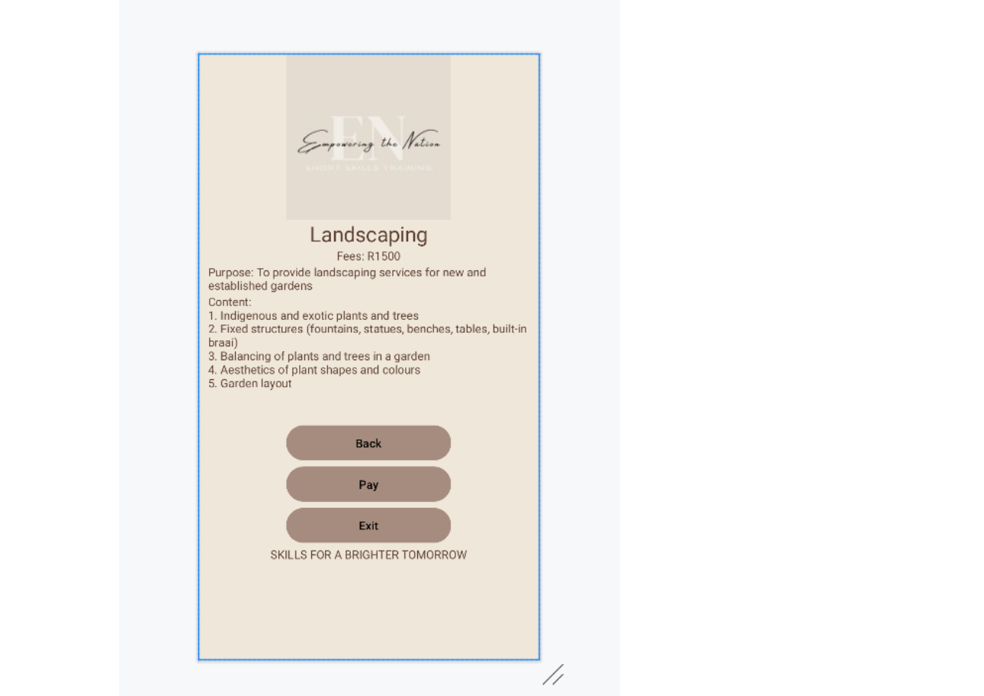
EMPOWERING THE NATION LANDSCAPING SCREEN

Slide 28

EMPOWERING THE NATION LIFE SKILLS SCREEN

Slide 29
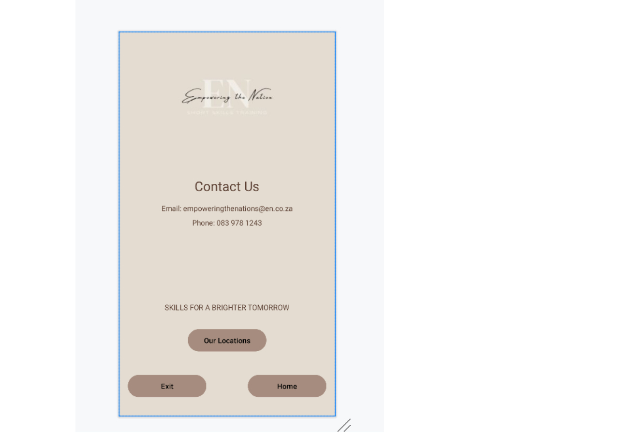
EMPOWERING THE NATION CONTACT US SCREEN

Slide 30

EMPOWERING THE NATION USER DETAILS PAGE

Slide 31

Speech
Greetings for the morning, It is my honour to introduce "Empowering the Nation," a platform that consists of a website and a mobile application. My name is Kutlwano Baloyi. In addition to being the only developer in charge of all code and CSS design for the website and mobile app, I also act as the initiative's spokeswoman. Empowering the Nation, which was founded in 2018 in Johannesburg, South Africa, provides a variety of courses in two timeframes: six-week and six-month programs. For instance, among other things, we provide a more streamlined six-week Child Minding training in addition to a thorough six-month First Aid course. Users are welcomed with our emblem and the mission statement that guides our organisation when they visit the Empowering the Nation website.

Slide 32

Speech
A drop-down menu under the "Courses" tab is one of the homepage's four primary tabs. Users are given the option to choose between six-month and six-week programs after choosing the "Courses" button. They are taken to a website that contains the course's details after selecting a certain course. For example, choosing the six-month First Aid course will take visitors to a specific page with details on the cost of the course, its objectives, and the main subjects it covers. Other six-month courses including Sewing, Landscaping, and Life Skills follow the same methodology.

Slide 33
Speech
When customers choose the Child-Minding course under the six-week program category, they are taken to a page that includes a brief description of the course, its contents, and its costs. All other six-week courses, including Cooking and Garden Maintenance, follow the same procedure.
Users can enter their contact information, select a course of interest, check the course costs, and see any available discounts that have been calculated into the overall cost on the "Fees" page.
Lastly, the contact page offers all of Empowering the Nation's pertinent contact details, including our physical locations where people can get in touch with us directly.

Slide 34

Speech
The Empowering the Nation APP's login screen welcomes users with our unique logo and offers them the option to join up or log in, which is what motivates our company. Users are shown options for both six-month and six-week programs on a welcome page after choosing to log in. They are taken to a screen that lists the specifics of the course after selecting one. When users choose the Child-Minding course in the six-week program category, a screen with a synopsis of the course, its contents, and costs is displayed. The following procedure applies to all other six-week courses, including Cooking and Garden Maintenance.

Slide 35

Speech
Users who choose the six-month First Aid course will be taken to a specific screen with details on the cost of the course, its objectives, and the main subjects it covers. Other six-month courses including sewing, landscaping, and life skills follow the same methodology, which is once more shown as follows. The contact screen offers all Empowering the Nation's pertinent contact details, including our physical locations where users can contact us directly. Users can select a course of interest, check the course fees, and see any applicable discounts computed within the total cost by using the "Fees" screen, which also shows the calculated fees and discounts included.

